Slide 1
Wagner Group Activity in Africa
ECON 8320: Tools for Data Analysis
Emily Wright

Slide 2
Armed Conflict Location & Event Data Project
(ACLED)
Database includes locations, dates, fatalities, event types, and actors
API usage

Slide 3
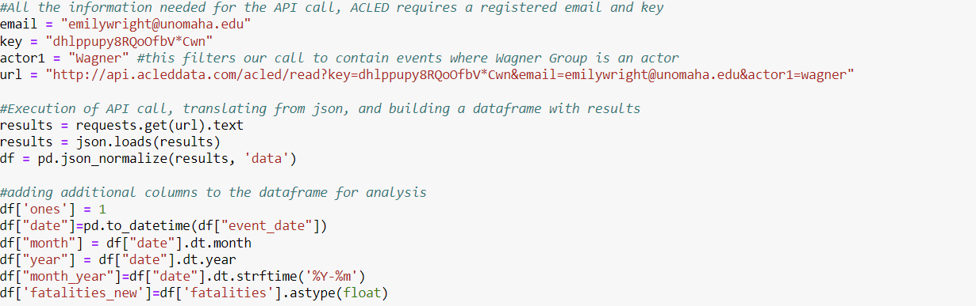
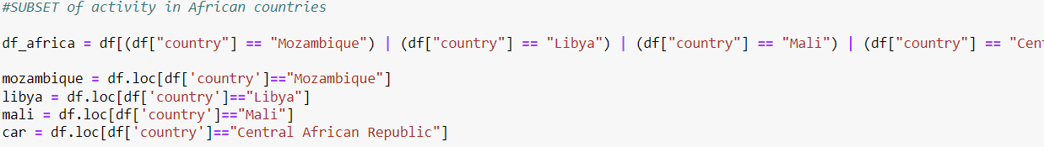
API call & dataframe code

Slide 4
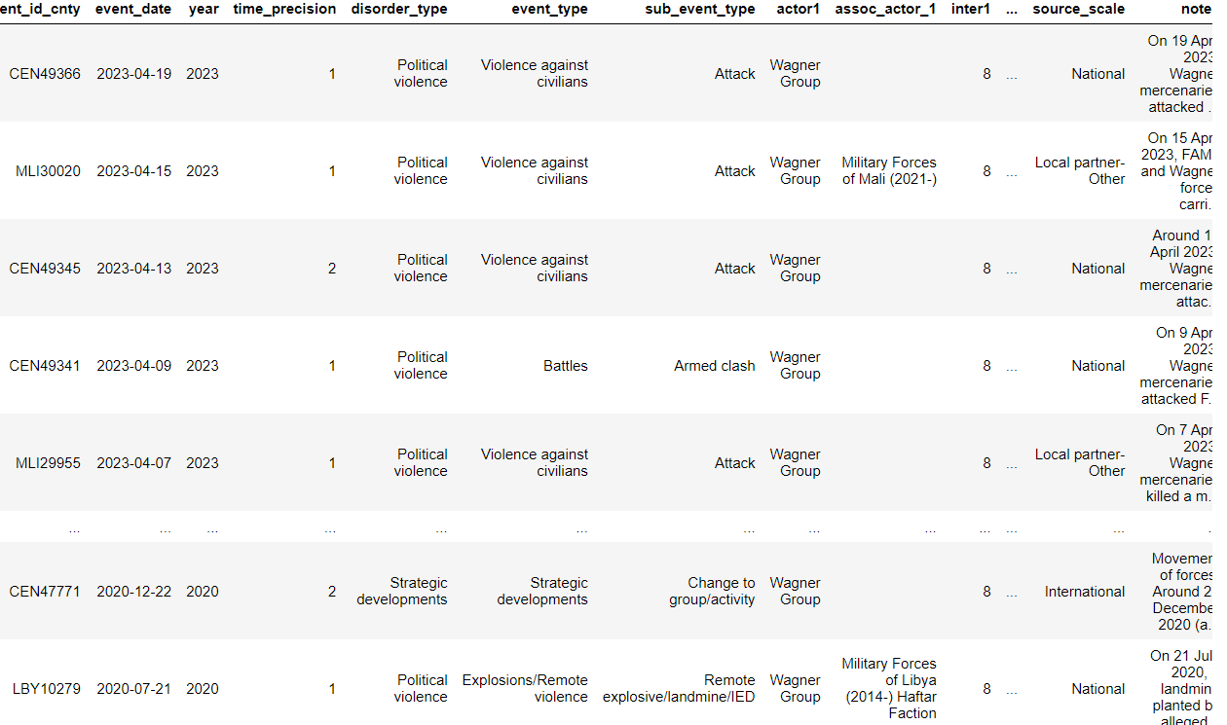

Slide 5
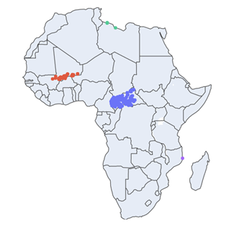
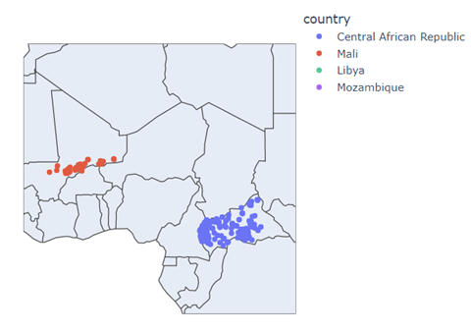
African countries of interest
*activity near borders (Mali: Burkina Faso, Niger; CAR: Chad, Cameroon)

Slide 6
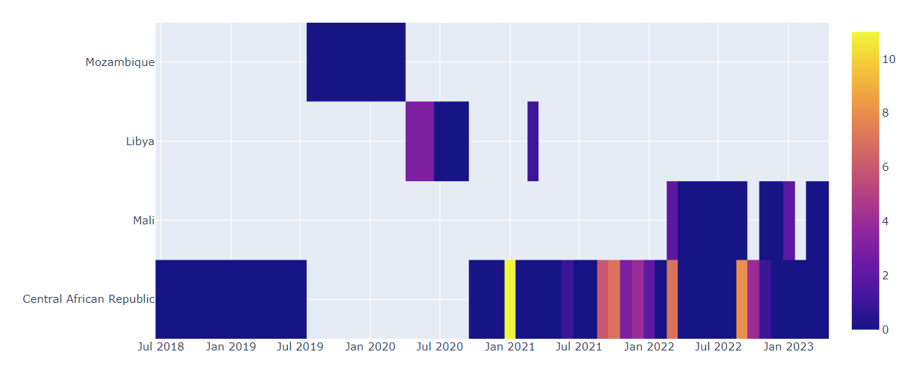
Fatalities per Country per Month

Slide 7
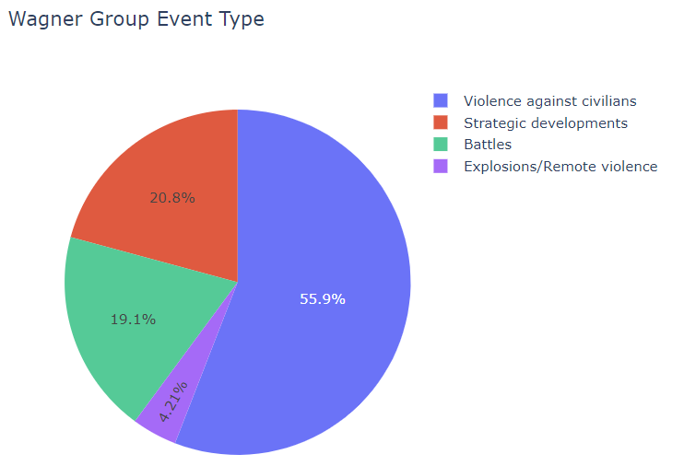
Event Type Frequency
Violence against civilians: abduction, sexual violence, attack
Strategic Developments: arrests, looting/property destruction, non-violent transfers
Battles: armed clash, territory takeover
Explosions/Remote Violence: chemical weapons, air/drone strikes, missile attacks

Slide 8
Takeaways
Increased activity in Ukraine has decreased activity in African countries
Main countries of operation: Central African Republic and Mali
  Increased activity in Mali since 2022
  Decreasing activity in CAR
Events primarily focused on violence against civilians
  Battles and armed clashes have led to over 1,200 reported fatalities in Africa

